Slide 1
Introduction to Special Education and Annual Required Paraprofessional Training

Slide 2
Paraprofessional Defined
A district employee who is primarily engaged in direct instruction with one or more pupils for instructional activities, physical or behavior management, or other purposes under the direction of a regular education or special education teacher or related services provider. MN Statue 3525.0200, Subp. 10a
Related Service Provider: Speech-Language Pathologist (SLP), Occupational Therapist (OT), Physical Therapist (PT), Deaf/Hard of Hearing (DHH), Developmental Adaptive Physical Education (DAPE)

Slide 3
BASIC PRINCIPLES OF HUMAN DEVELOPMENT
Development in all people is similar.
Development is an orderly process with stages (patterns) that can be predicted.
Development proceeds from the general to the specific.
Development proceeds from the upper portions of the body toward the lower portions- from head to toe.

Slide 4
BASIC PRINCIPLES OF HUMAN DEVELOPMENT (CONTINUED)
Development proceeds from the center of the body to the outer body parts.
Development proceeds at different rates.
Development can proceed at different rates within an individual person.
Physical, cognitive, social and emotional development are interrelated and affected by the interaction of heredity and environment.

Slide 5
FACTORS THAT MAY IMPEDE HUMAN DEVELOPMENT
Causes of Disabilities
- Genetic
- Environmental
- May occur during the prenatal, natal, or postnatal periods
* Genetic Factors
- Sometimes disabilities and other conditions are inherited
- Down Syndrome, Hemophilia
* Environmental Factors
- Toxins in the air
- Water Pollution
- Lead Poisoning
- Poverty

Slide 6
FACTORS THAT MAY IMPEDE HUMAN DEVELOPMENT (continued)
Prenatal (Before birth)
* Poor nutrition
* Hepatitis or measles
* Drug use, alcohol or smoking * Natal (At the time of birth)
* Medicine taken during pregnancy * Premature
* Food additives * Loss of oxygen
* Long Labor
* Excessive hemorrhaging
Postnatal (After birth) * Early separation of the placenta
* Injury to central nervous system * Direct Injury to the head
* Severe blows to head (accident or abuse)
* Inability to breathe
* Poisoning
* Tumors
* Infectious diseases such as Meningitis or Encephalitis

Slide 7
WHAT IS SPECIAL EDUCATION?
Special education is governed by federal law in most educational jurisdictions. Under Individuals with Disabilities Education Act (IDEA).
* Special Education is defined as, “Specially designed instruction, provided at no cost to the parents, to meet the unique needs of a child with a disability, including adapting content, teaching methodology and delivery instruction to meet the appropriate needs of each child.

Slide 8
WHAT IS SPECIAL EDUCATION?
(continued)
Special Education broadly identifies the academic, physical, cognitive and social-emotional instruction offered to children who are faced with one or more disabilities.
The range of special education support will vary based on need and educational jurisdictions.

Slide 9
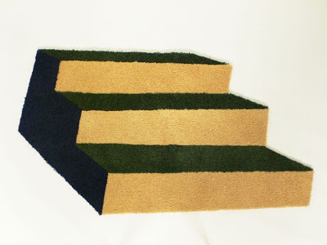
3 Steps to Special Education
Pre-referral
* Need interventions in place prior to referral
Evaluation
* A team takes a comprehensive look at the needs of the student
Develop an IEP (Individual Education Program)
* If eligible, an IEP is developed for that student

Slide 10
Basis for all Special Education Processes:
IDEA: Individuals with Disabilities Education Act
Federal law that requires schools to serve the educational needs of eligible students with disabilities.
Access to a free and appropriate public education (FAPE), just like all other children.
Required to provide special education in the least restrictive environment- in general education whenever possible.
* MN Rules and Statutes

Slide 11
How Can A Student Qualify for Special Education Services in MN?
Autism Spectrum Disorders (ASD)
Blind-Visually Impaired
Deaf-Blind
Deaf and Hard of Hearing (DHH)
Developmental Cognitive Disabilities (DCD)
Developmental Delay (DD)
Emotional or Behavioral Disorders (EBD)
Other Health Disabilities (OHD)
Physically Impaired (PI)
Severely Multiply Impaired (SMI)
Specific Learning Disability (SLD)
Speech or Language Impairments
Traumatic Brain Injury (TBI)
Excellent source of information is: http://www.nichcy.org

Slide 12
Autism Spectrum Disorder
Autism Spectrum Disorders (ASD) means a range of a neurodevelopmental disorders in which a child exhibits impaired development in social interaction and language, and repetitive, or a restricted range of activities. They affect up to 1.5 million Americans, and is the nation’s fastest growing area of development disabilities.
Autism is often referred to as a spectrum disorder, meaning that the behavioral symptoms and characteristics can present themselves in a wide variety of combinations, from mild to severe. Although autism is defined by a certain set of behaviors, children and adults can exhibit any combination of behaviors, in any degree of severity. For example, two children, both with a diagnosis of Autistic Disorder, can act very differently from one another, demonstrate different needs and thus may respond to interventions differently.

Slide 13
Developmental Cognitive Disability
> Developmental Cognitive Disability (DCD) is defined as a condition that results in intellectual functioning significantly below average and is associated with concurrent deficits in adaptive behavior that require special education and related services.

Slide 14
Emotional or Behavioral Disorders
> Emotional or Behavioral Disorders (EBD) is a wide range of complex and challenging emotional or behavioral conditions. Medical conditions, genetic dispositions, biological and psychological conditions can impact a student’s ability to learn and function at school. A student who needs specialized services for emotional or behavioral supports may be considered for special education under the EBD category.

Slide 15
Specific Learning Disability
> Specific Learning Disability (SLD) is a disorder in one or more of the basic psychological processes involved in understanding and using language, spoke or written, that may manifest itself in an imperfect ability to listen, think, speak, read, write, spell, or do mathematical calculations. The term includes such conditions as perceptual disabilities, brain injury, minimal brain dysfunction, dyslexia, and developmental aphasia.

Slide 16
SIMULATION
THE FRIEMBLY BOG
Once ubom a tmie there was a friembl dobl. His name saw Jake. Jake belombeb to Bavig and Bhte. Davib and Bhte aar tins. They ar nime yrse dol. On e tome Jak went dow to the cellar. H was a ducket of soab. The tins were doing to wash the car. He liked some saop buddles out fo the ducket. When he darked, dig dubbles ca me out of hi s muth!
Last sum mre Jak founb a grenb. His frien sqw a tac named Freb. They blayde all bay. They nar aroumb and aroumbb tye yarb. Jake chased the tac ub te tre. Freb climded up easily. Jake trieb t and trieb dut ehe slib back bown!
THE FRIENDLY DOG (Translation)
Once upon a time there was a friendly dog. His name was Jake. Jake belonged to David and Beth. David and Beth are twins. They are nine years old. One time Jake went down to the cellar. He saw a bucket of soap. The twins were going to wash the car. He licked some soap bubbles out of the bucket. When he barked, big bubbles came out of his mouth!
Last summer Jake found a friend. His friend was a cat name Fred. They played all day. They rean around and around the yard. Jake chased the cat up the tree. Fred climbed up easily. Jake tried and tried but he slid back down.

Slide 17
What learning might be like without accommodations and modifications…………
http://www.pbs.org/wgbh/misunderstoodminds/experiences/attexp2a.html
http://www.pbs.org/wgbh/misunderstoodminds/experiences/readexp1b.html
http://www.pbs.org/wgbh/misunderstoodminds/experiences/mathexp3a.html

Slide 18
What Do We Need To Place in Sped?
Meet criteria of one of the 13 disability categories
Have a need for special education services due to disability
Must have BOTH in order to receive services

Slide 19
What Is An IEP?
Individual Education Program
Developed by a team including the child’s parent(s), teacher(s), and supporting school staff.
The team meets annually (at a minimum) to review and update the IEP. Meet every 3 years to re-evaluate if the student continues to be eligible for services and determine needs.

Slide 20
IEP cont.
Legally Binding Document
States where services a student will receive and why
Based on special education needs identified through a comprehensive evaluation process
Planned at an IEP team meeting
Includes the student’s
- Placement
- Services (LRE)
- Academic and Behavioral Goals
- Accommodations and Modifications Needed
- Paraprofessional Support and Duties
- Positive Behavioral Support Plan (if needed)

Slide 21
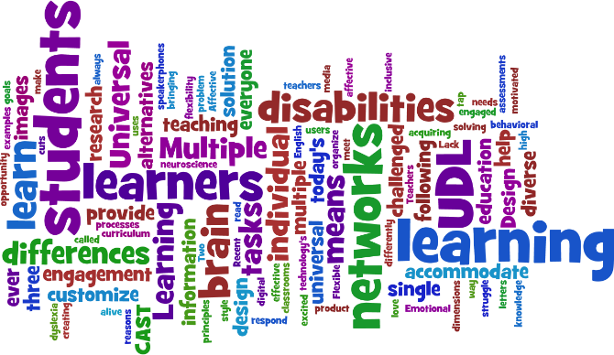
Some Thoughts on Special Ed
Services are NOT a place and must be individualized/least restrictive
The IEP should ensure access to general education
Fair does NOT mean equal

Slide 22
Top 10 List for Paraprofessionals
TOP 10

Slide 23
Know both your students and the disabilities they manifest.

Slide 24
Maintain confidentiality and follow school district policies for protecting the health, safety, and well being of students.
Shhh!

Slide 25
What Information is Confidential?
Personally Identifiable Information
- Student’s name, parent’s name, address, social security number
- Personal Characteristics
- Other Information that makes the student easily identifiable
Educational Records
- Everything in institutional records maintained for each student…used in making decisions that affect the life of the student
- Includes special education files and some information in the permanent file
* The fact that the student is in special ed
* Information read in reports
* Information gained by observing the student
* Information verbally disclosed by family or service providers
* Also: list of students in special education

Slide 26
How is confidentiality preserved?
Special Education Files are maintained in a locked cabinet
Access is denied to those who do not have a “legitimate education interest or need to know”
Access is denied to outside agencies that do not have written parental consent
Employees respect the student’s and family’s right to privacy
Access logs are used
Employees learn how to “field” questions from others who request confidential information

Slide 27
Confidentiality Pointers
Avoid using names if you are asked about your job
Suggest that questions about a student are best directed to the case manager or building principal
Do not share other student names or information regarding their programs with parents during IEP meetings, conferences, or informal conversations
Information regarding specific students and programs should not be shared in the lunch room, staff lounge, office areas, in the community, or any other setting

Slide 28
3. Always look beyond your student’s behaviors to determine the functions those behaviors serve.

Slide 29
Don’t be blinded by your student’s strengths, nor hold them to standards they cannot meet.
“I can suck pudding up my nose and blow it
out the corner of my eye, but they still won’t
put me in the gifted class at school!”

Slide 30
5. Manage relationships with students, parents, teacher and school.

Slide 31
Roles and Responsibilities
Directly or indirectly assist and support the provision of services to students with disabilities in order to help them access the general education curriculum in as independent a manner as possible.
The role and assignments of a paraprofessional are not defined by a particular student, setting, or program but rather by the student’s needs as determined by the IEP.
May vary based upon specific assignment.
May change anytime based upon administration or teacher examination or reexamination of student need.

Slide 32
Roles and Responsibilities Cont.
Understand the student’s needs
Understand the student’s adaptations (accommodations and modifications)
Implement those accommodations and modifications as needed in the classroom
Communicate with IEP managers and classroom teachers regarding “what’s working and not working”
Collaborate/team with staff to meet the student’s needs on a daily basis.

Slide 33
Supporting Academic Development
Carry out the instructional programs and review lessons as developed by the supervising teacher
Assist individual students or groups of students in performing activities initiated by the teacher
Reinforce concepts and skills introduced by the teacher in all learning environments
Keep students on task
Implement assistive technology
Implement accommodations indicated by the IEP as directed by the special education teacher

Slide 34
Supporting Social Integration
Redirect student behavior and implement behavior management plans
Facilitate interaction between students with disabilities and peers
Teach and model strategies to peers
about how to interact with the student
with a disability
Support the development of communication skills

Slide 35
Supporting Functional Skills
Assist the student with daily living skills and needs such as eating, toileting, grooming, dressing, etc.
Assist in transferring, positioning, and mobility needs as directed by the physical therapist, occupational therapist, or other special education or related service providers
Act as a job coach
Assist in carrying out tasks
related to transition needs

Slide 36
Serving as a Communication Link
Provide the special education teacher/staff information about general education assignments, activities, and student participation and behavior
Inform general education staff about student programs as adaptations
Observe, record, and collect data as directed
Share information with other paraprofessionals or family as directed
Attend IEP meetings at the request of the administrator, teacher, or parent

Slide 37
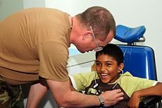
Supporting Medical Needs
* With training and under the supervision of the
appropriate professional, be willing to:
- Administer tube feedings
- Administer medications
- Recognize and respond to critical symptoms
- Use instruments and procedures specifically related
to the disability or medical condition
- Accompany and assist medically fragile students in
all settings where the district is responsible
- Carry out motor programs under the direction of
Occupational and/or Physical Therapists

Slide 38
Role Clarification
Supervising Teacher | Paraprofessional
Administers assessments and identifies educational needs | May be asked to observe student and collect data on specific academic or behavioral tasks
Plans instructional programs | Assists with the planning process
Grades student performance | Checks and scores student work
Takes complete responsibility for each NEW activity | Reinforces and reviews concepts and skills
Revises instructional program | Monitors student progress and reports to supervising teacher
Designs instructional materials | Constructs materials designed by supervising teacher
Designs and implements behavior and intervention plans | Monitors and reinforces student performance during behavioral interventions

Slide 39
Role Clarification Cont.
Supervising Teacher | Paraprofessional
Communicates with parents | Communicates information to supervising teacher/case manager
Responsible for discipline | Disciplines students following behavior management techniques set up by the supervising teacher
Attends in-service meetings | Attends paraprofessional development trainings
Provides curriculum accommodations/ modifications that allow student to participate in general curriculum | Constructs materials to support accommodations

Slide 40
6. Exercise vigilance in fading back prompts and promoting competence and independence in your students.

Slide 41
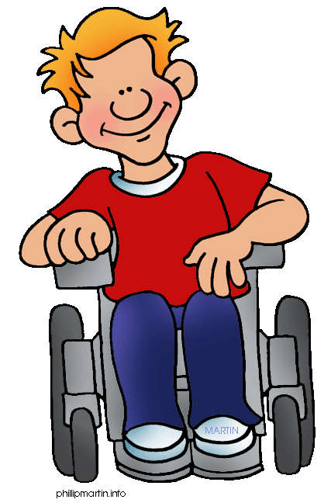
The goal of Special Education is to help students become independent and contributing members of society.

Slide 42
Importance of Independence
Student Motivation and Engagement increases
Builds self-confidence and high personal expectations
Unnatural prompts create a continued need for unnatural prompts
Doing things independently can be more dignified
More age-appropriate
Opportunities for assessment of true skills
Allows natural opportunities for praise and reinforcement

Slide 43
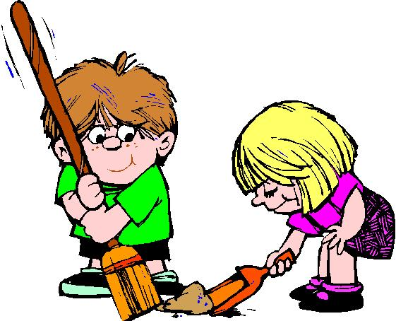
“Never help a child with a task at which he feels he can succeed” Mara Montessori

Slide 44
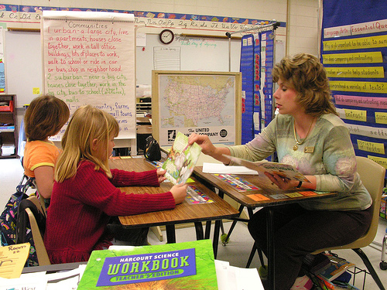
Close proximity contributes to:
The less the teacher takes ownership for the student
The more separated the student becomes from his/her peers
The more dependent the student becomes on adults
The less the student initiates interactions with his/her peers
The less peers initiate interactions with the student
The less attention the student receives from the classroom teacher
The less the student feels in control of his learning
The less the student takes responsibility for his/herself
The less the student develops socially and emotionally

Slide 45
Levels of Support
Transitional: Supports only needed on a temporary basis.
Low: Support is always available, but not needed on a regular basis.
Medium: Support is necessary on a regular basis.
High: Support is absolutely necessary for the student to learn and must be provided consistently.

Slide 46
Levels of Support
Transitional Support
The amount of support (low, medium, high) is provided temporarily to assist the student in gaining independence in new environments, activities, and/or acquisition of new concepts.

Slide 47
Levels of Support
Transitional Support Example:
Maya never required specific support in the elementary school cafeteria where she was independent during lunch. During the first two weeks of middle school, Maya was provided a medium level of support to transition into the middle school cafeteria where procedures, routines, communication, and social skills were much more complex. After two weeks, Maya understood the requirements and the culture of the middle school cafeteria and no longer required the additional support.

Slide 48
Levels of Support
Low Support
This level of support is always available but not needed on a regular basis by the student. The student would be able to function in the environment without the support, just not as successfully.

Slide 49
Levels of Support
Low Support Example:
Tony attends a general education math class as do three other students with disabilities. The paraprofessional is always in that class and is available to support Tony when needed. Typically, Tony only requires help two or three times a week and it is usually to check his work or clarify activity or assignment directions.

Slide 50
Levels of Support
Medium Support
This level of support is necessary on a regular basis in order for the student to be successful or learn in the environment.

Slide 51
Levels of Support
Medium Support Example:
Olivia participates in a vocational training program in the community. Each afternoon the paraprofessional accompanies her to the training site and provides verbal cues to get Olivia started on job tasks. At times, the para goes to a nearby table so that Olivia can work independently. She will, however, provide prompts when Olivia appears to be struggling to complete the next step in the task sequence.

Slide 52
Levels of Support
High Support
High levels of support are generally intrusive in nature. The support is absolutely necessary for the student to learn and must be provided consistently. The student could not function in the environment without the support.

Slide 53
Levels of Support
High Support Example:
Avery attends computer lab with hi peers. Although he enjoys the class, he needs a high level of support. The para sits next to Avery and provides both physical and verbal cues. She uses hand-over-hand support to help him turn on the computer, use the mouse to select the desired program and to complete the task. She provides many verbal cues to help Avery stay focused and on task. Without the paraprofessional support, Avery would be unable to access this computer lab with his peers.

Slide 54
What is a Prompt?
Cues students need to respond to in the school environment.
Example: timer set in a classroom to cue the student when some activity is ending.
Goal of prompting is to add just enough information that the student can learn to do some skill independently.
Goal is also to prompt a student in a manner that the prompt can then be faded.

Slide 55
Increasing Prompt Hierarchy
(Least-to-Most” Prompting)
INDEPENDENT: the student knows how to do this task without any help from you. THIS IS OUR GOAL!!!
INDIRECT VERBAL: An indirect verbal prompt tells the student that something is expected but not exactly what. Example: “What next?” “Now what?” Start here when using the increasing hierarchy.

Slide 56
Suggestions for Indirect Questions
“What does ________ have in her hands?”
“When is your _________ due?”
“Where should your eyes be?”
“Why are we putting our books away?”

Slide 57
Increasing Prompt Hierarchy Cont.
DIRECT VERBAL: This is a direct statement of what we expect the student to do or say. Example: “Come here.” “Put the glass on the counter.” This level of prompt requires that the student be able to follow your direction. If the indirect verbal assist didn’t work, move to this level.
GESTURE: Pointing, facial expression, mouthing words silently or otherwise indicating with a motion what you want the student to do.
MODELING: Modeling is simply showing the student what you want him or her to do. You do not physically tough the student. In order for modeling to work, the student must know how to imitate another person’s actions.

Slide 58
Increasing Prompt Hierarchy Cont.
PARTIAL PHYSICAL ASSIST: Less intense or intrusive than a full physical assist. If full physical assist is hand-over-hand, the partial physical assist can be visualized as providing minimal supportive guidance—touching the wrist to stabilize handwriting.
FULL PHYSICAL ASSIST: Hand-over-hand assistance to complete the targeted response. This is usually used when the target response is motor in nature. For example, a full physical assist might entail putting your hand on the student’s hand and moving the student’s hand through the action of writing his or her name.

Slide 59
“A major factor is the ‘mindset’ of the paraprofessional. It would be much easier to assist a student than it is to promote independence. The para must focus on the student’s independence consistently; the bigger picture must be considered at all times.”
-Anita Haines

Slide 60
Be proactive both in seeking out information to help your students, and in preparing and implementing the support that they need to be successful.

Slide 61
Assistive Technology
A device or service which helps a student gain independence in his or her school environment.
For people without disabilities, technology makes things easier. For people with disabilities, technology makes things possible. -IBM training manual 1991

Slide 62
Assistive Technology (AT) Examples
Activities of Daily Living (ADLs)- adapted utensils, adapted devices for hygiene, dressing aids
Communication- symbol systems, communication boards, simple voice output devices, voice output with dynamic display, speech synthesizers
Computer access- key guards, alternate keyboards, adapted mouse, trackball, touch window, switch with scanning, voice recognition software
Environmental control- remote controls, switches that can activate electronic devices such as a blender, fan, radio or lamp
Hearing- hearing aids, closed captioning, flash alert on computer, FM system
Learning/Studying- picture schedule, electronic organizers, digital recorders, software for concept development, handheld computers
Math- money, calculator, talking watches/clocks, talking calculator, scanning calculator, math software

Slide 63
AT Examples Cont.
Mobility- walkers, wheelchairs (manual and powered), bikes, mobile standers
Motor aspects of writing- pencil grips, adapted papers, slant board, portable word processor, computer with word processor
Positioning/Seating- non-slip surfaces, floor sitters, straps, trays, custom fit wheelchair
Reading- changes in text size or background color, symbols with text, scan and read programs, electronic books
Recreation- adapted toys, adapted sporting equipment, arem supports for drawing, computer games
Vision- magnifiers, large print books, screen magnifier, books on CD/DVD, text reader, screen reader, Braille
Writing- talking spell checker or dictionary, word prediction software, talking word processor

Slide 64
Communicate!
Regularly ask for clarification on duties from the special education teacher and other providers
- Behavior plans
- Accommodations and modifications
- Issue that is occurring in the classroom
- Discuss when things aren’t going well
* Clarify the process to handle/prompt/etc.
* Problem solve together if a change needs to be made

Slide 65
Become familiar with building and school policies. (Ex. building handbook, paraprofessional handbook, vulnerability & reportability via Safe Schools, etc.)

Slide 66
Put the student first!

Slide 67
Get to know the students you work with
* Develop a relationship
* Find out things they like
* Read the IEP, behavior plan & ASK questions!
Focus on the Students
* Avoid socializing with adults while students are around
* Cell phone use only during breaks and lunch
* Interact with the student you are assigned

Slide 68
10. Perform your duties mindfully, responsibly, and respectfully at all times.

Slide 69
TOOLBOX of SUCCESS TIPS
Be on time. Regular attendance is a must.
* Continuity in staff for our students is our #1 priority
Be a Team Player
* Take concerns directly to the person involved
* Avoid venting in the workroom or with other individuals
Maintain Respect for students & families
Breaks are 15 minutes start to finish
* Break starts late, must still end at the
scheduled time
* Schedule change may cause a break to
be eliminated for the day
* Student need supercedes scheduled breaks

Slide 70
Educational Staff are Working for the Same Purpose.
We want to create lifelong learners who can manage themselves to the best of their ability and be a contributing member to their community.

Slide 71
Free Online Resources
www.commonsensemedia.org/guide/special-needs (free webinars)
www.ablenet.com (scroll down toward the bottom of the page for the box to free paraprofessional development)
http://paralink.org
http://ici.umn.edu/para/ (MN Para Consortium)
www.nichy.org (National Dissemination Center for Children with Disabilities)
www.autisminternetmodules.org
www.myinfinitec.org (need to be a member- some school districts are members)
www.atinternetmodules.org

Slide 72
If you have any questions regarding this power point please feel free to contact Janet Dirksen at janet.Dirksen@swsc.org
HUGE thanks go to Jackie Budden, Melissa Hanson, Deb Stoll, and Mary Margaret Mathers for sharing their materials for this power point.

